Slide 1
Artificial Intelligence Powered Research: A survey of the current and planned usage of AI across research disciplines in a High Performance Computing community
RMACC HPC Symposium
21 May 2025
Michael J Schneider, Mohal Khandelwal, Layla Freeborn

Slide 2

Slides
https://github.com/ResearchComputing/rmacc_2025

Slide 3

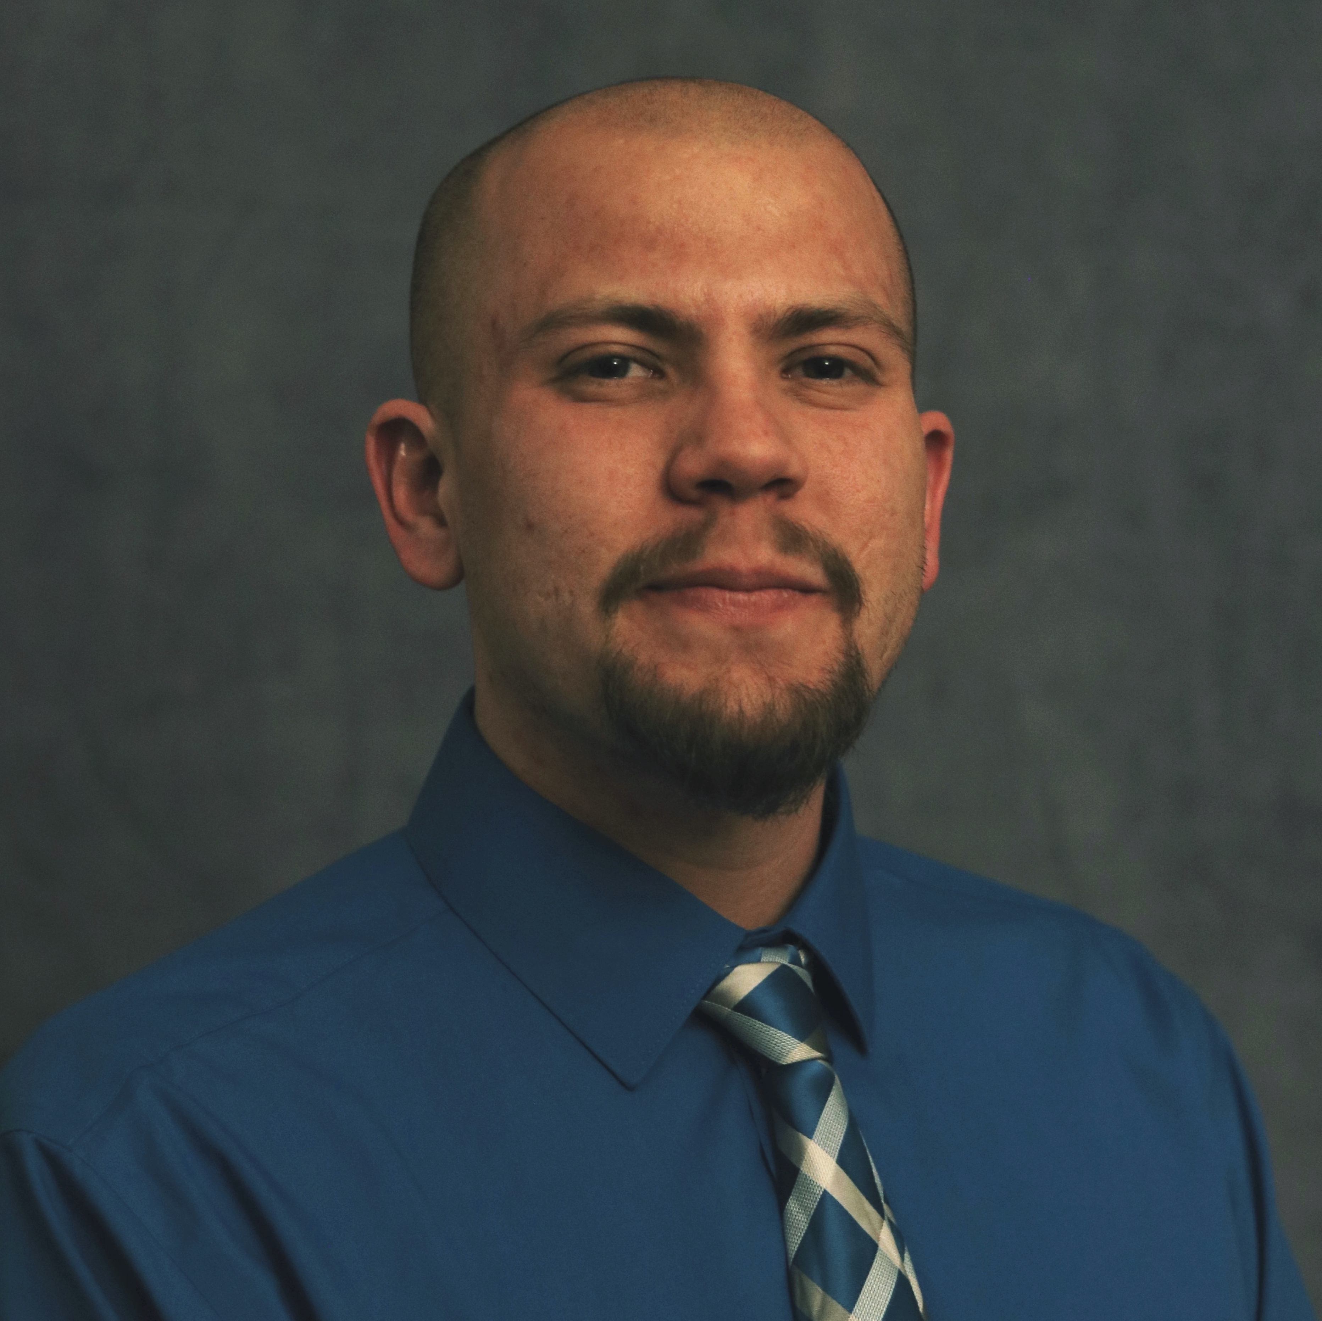
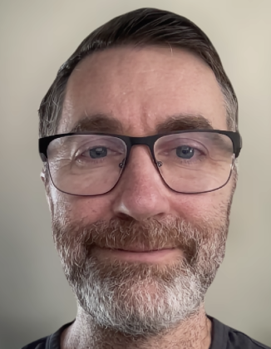


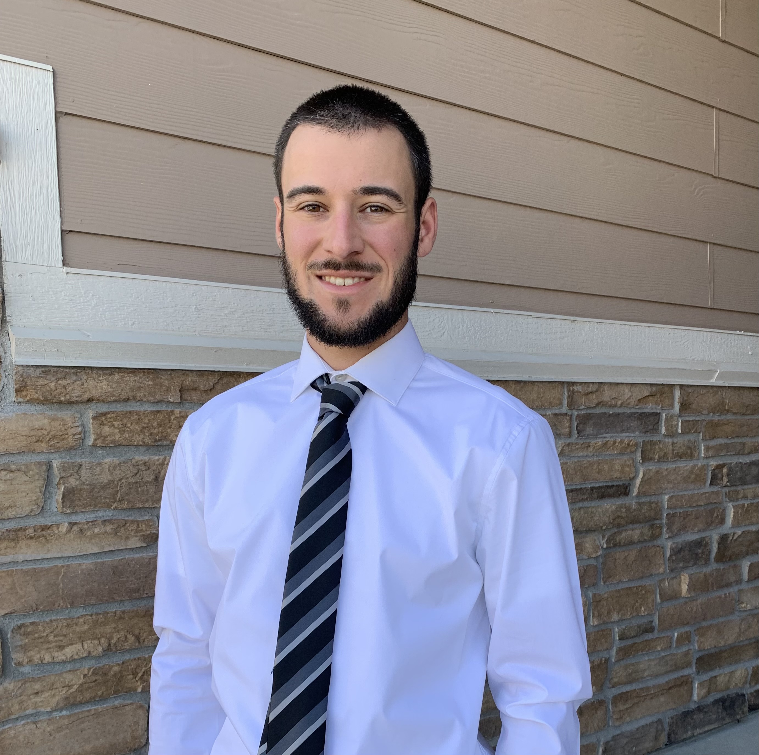


Teamwork!
Layla Freeborn
Brandon Reyes
Andy Monaghan
Michael Schneider
John
Reiland
Dylan Gottlieb
Mohal Khandelwal
Ragan
Lee

Slide 4
Survey goals
Understand CU Boulder and RMACC communities’ current and planned uses of AI and ML in their research.

Slide 5
Survey development and circulation
Reviewed by the CU Boulder Institutional Review Board (protocol number 24-0768). All participants provided their consent before participating in this study’s survey.
Questions based on an AI survey administered by the Center for High Performance Computing at Utah State University, a peer RMACC institution.
Survey emailed to members of the CU Boulder and RMACC user communities (thousands) and shared through the CU Boulder AI Community of Practice (AI CoP) Microsoft Teams channel (390 members).
Survey open for 6 weeks between February 10th - March 21st 2025.
Consisted of 6-19 questions, depending on how they answered a key screening question — “What is the status of AI in your research?”.

Slide 6
Survey respondents

Slide 7
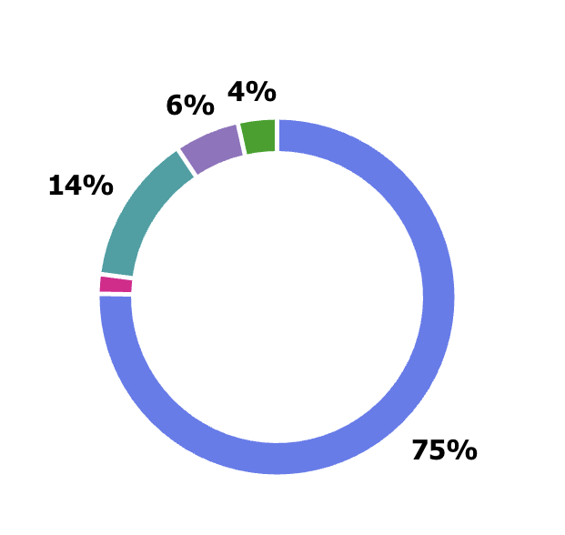
Respondent Primary Institution
Other RMACC
CSU
CU Anschutz
CU Denver
1%
CU Boulder

Slide 8



Survey screening question: What is the status of AI in your research?
1. AI has no use in my research/teaching
5 participants (3%)
2. Interested in AI but don’t know where to start
18 participants (12%)
3. Planning to use AI in the future (have some projects/ideas in the pipeline)
18 participants (12%)
4. Already using AI in my research/teaching
105 participants (72%)
Notes:
2 - Math & Stats 1 - Humanities 1 - Other 1 - N/A

Slide 9
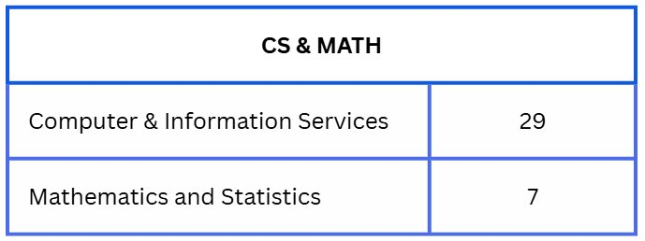
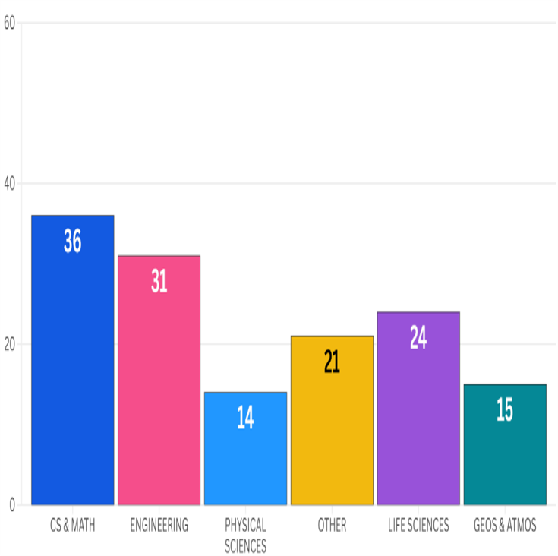
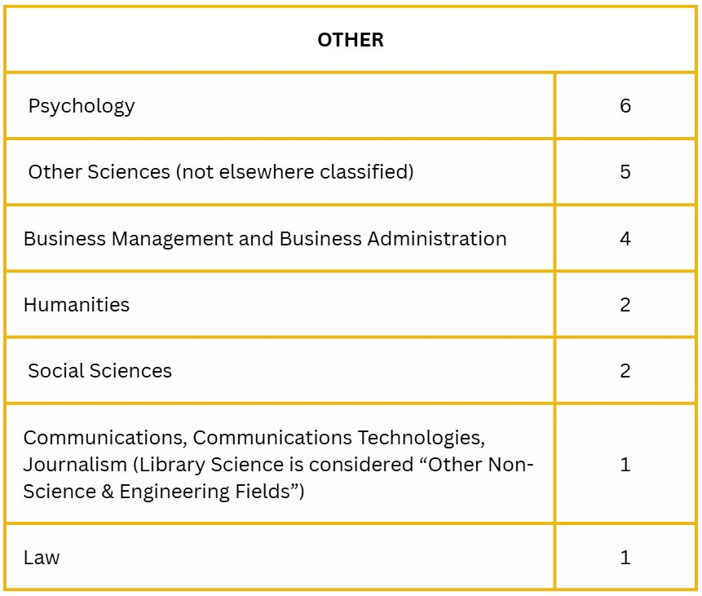
Respondent Disciplines

Slide 10
Survey analysis
We looked at discipline-specific differences in three areas:
Applications of AI methods and resource use
Data, hardware, and storage needs
AI research challenges and training needs
We hope to inform how best to support and engage professionals with varying backgrounds and usage patterns.

Slide 11
Applications of AI methods and resource use

Slide 12
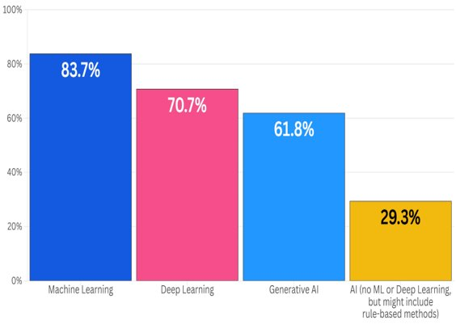
What type of AI are you using? (Select all that apply)

Slide 13
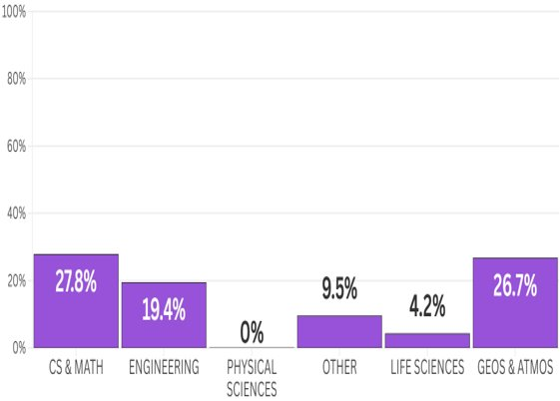
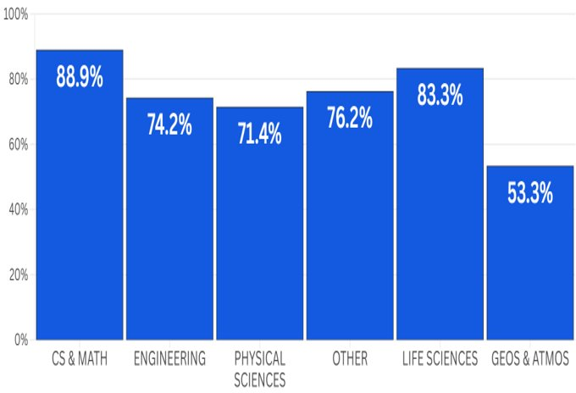
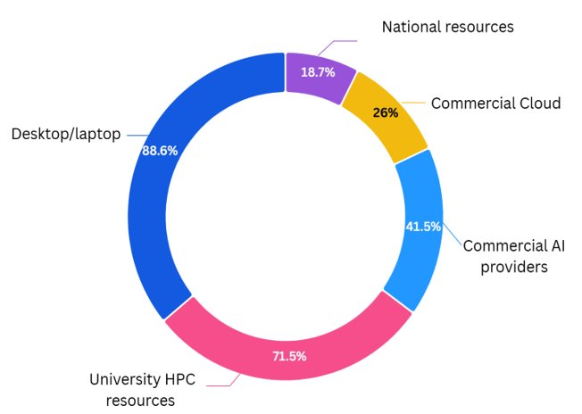
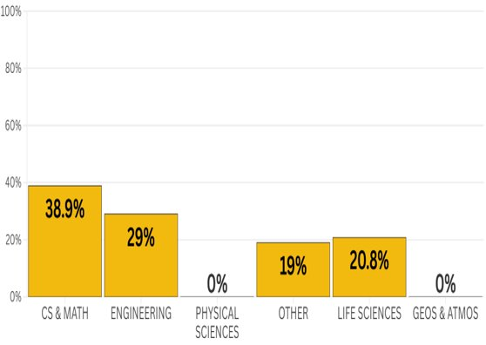
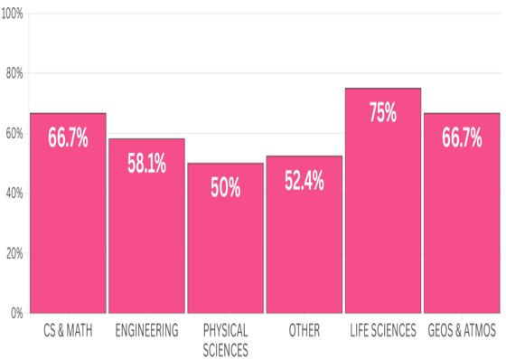
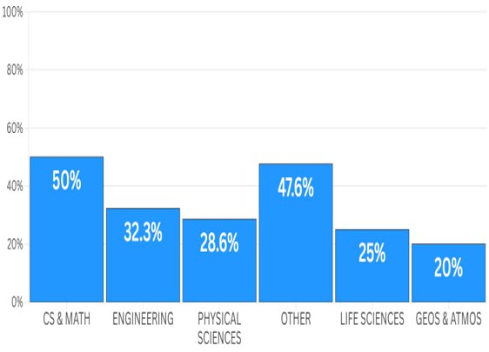
What computing resources do you use in your AI workflows? (Select all that apply)
18.7%
26%
88.6%
41.5%
71.5%
Notes:
Commercial AI providers = e.g. OpenAI
Across every discipline, desktops/laptops and CU Boulder HPC systems are the two most used computing resources in researchers’ AI workflows (Figure 1). Commercial AI provider (e.g., OpenAI) usage varies among disciplines, with it being the most common in CS & Mathematics (50%) and the least common among the Geosciences and Atmospheric Sciences (20%). The usage of national resources is highest among CS & Mathematics (27.8%) and Geosciences & Atmospheric Sciences (26.7%) and lowest among the Life Sciences (4.2%) and Physical Sciences (0%). The largest variation across disciplines is observed in commercial cloud usage, with CS & Mathematics respondents making up the largest percentage (38.9%) and Physical Sciences and Geosciences & Atmospheric Sciences reporting no usage.

Slide 14
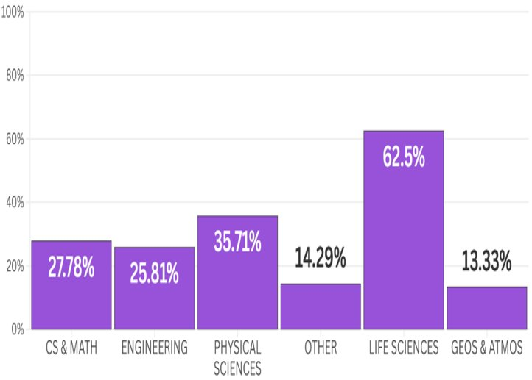
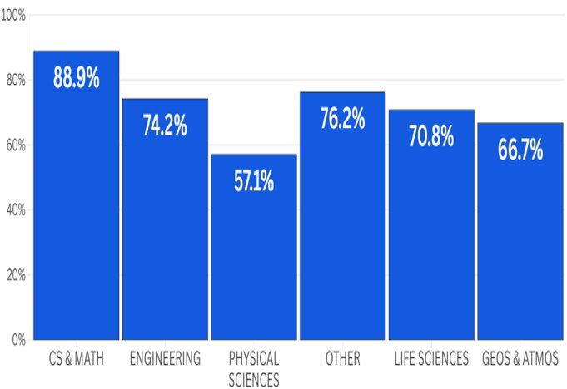
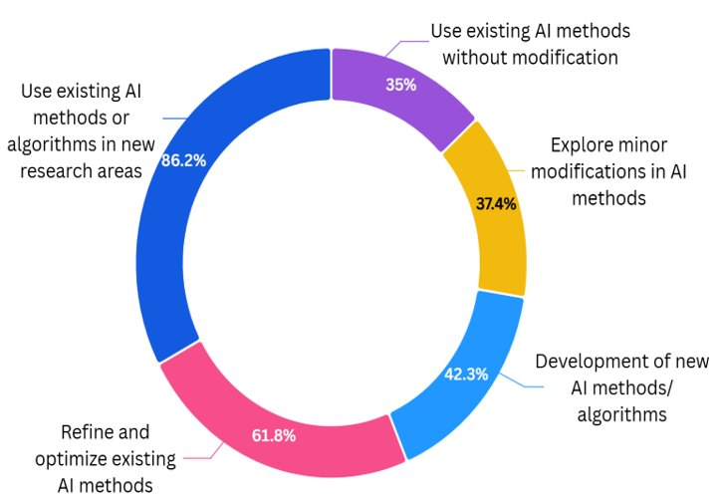
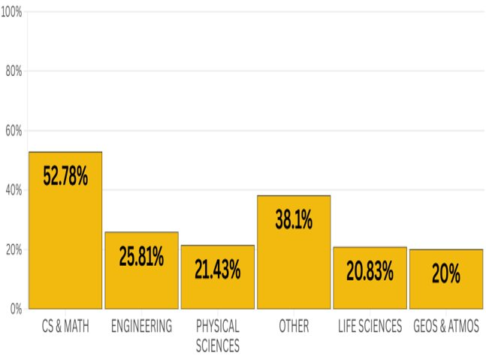
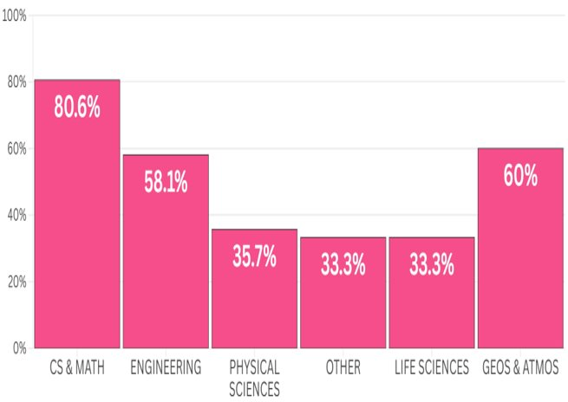
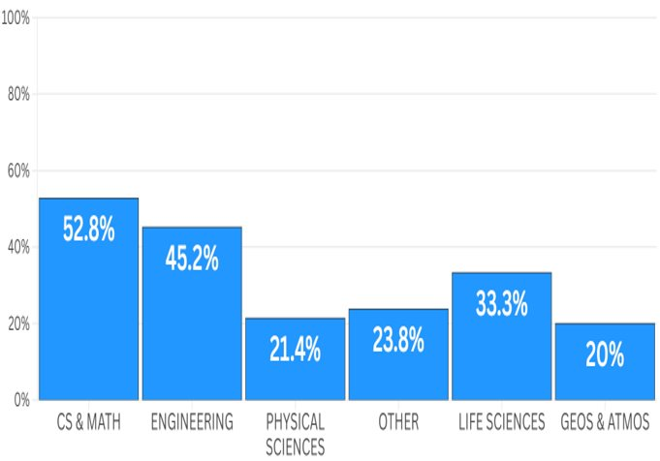
What is the level of AI use in your research? (Select all that apply)
35%
86.2%
37.4%
42.3%
61.8%
Notes:
Across disciplines, the most common way to use AI is to apply existing AI methods in new research areas (86%; Fig. 1a). The next most prevalent application is to refine and optimize existing AI methods (61.8%), followed by developing new AI methods/algorithms (42.3%), exploring minor modifications in AI methods (37.4%), and using existing AI methods without modification (35%). At the discipline level, the Life Sciences employ existing AI methods without modification at a higher frequency than any others, a result which may be explained by the widespread use of AlphaFold (Fig. 1b).

Slide 15
Data security, storage, and hardware needs for AI research

Slide 16
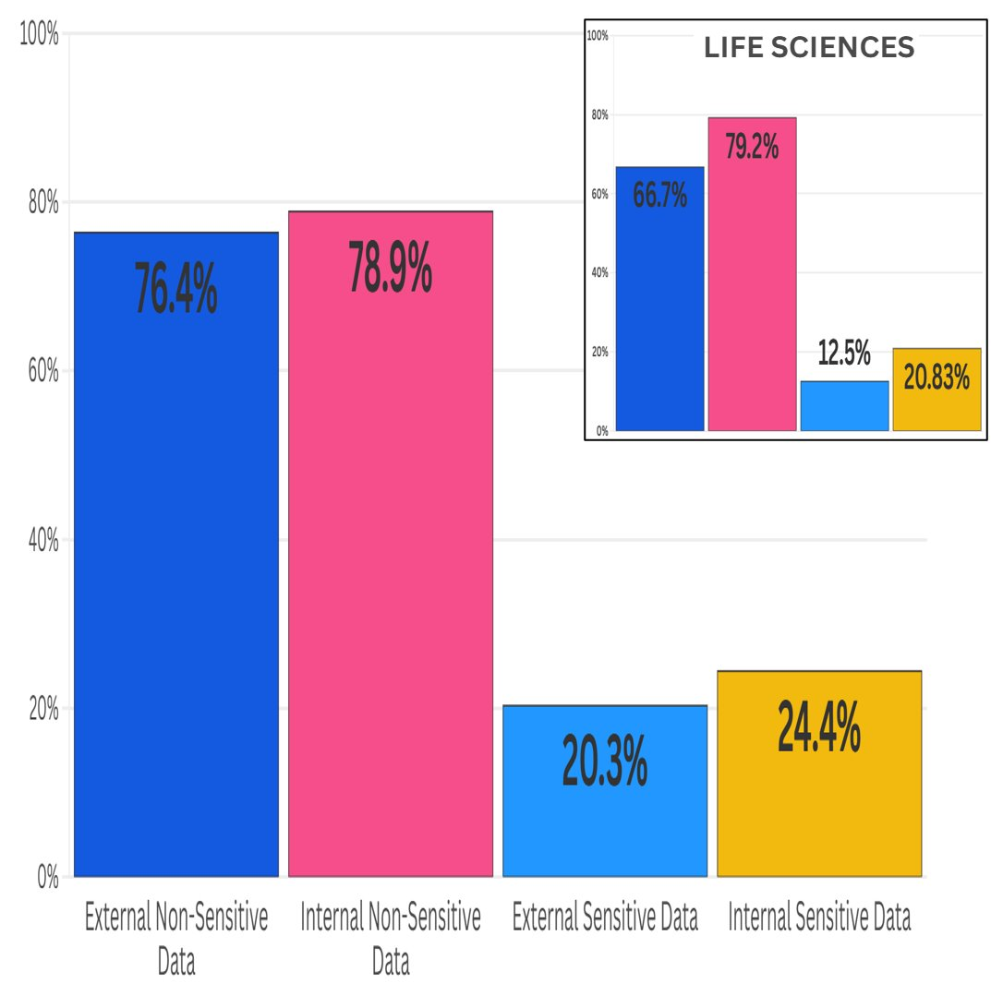
What types of data are you interested in using in your AI research? (Select all that apply)
Notes:
To understand the need for secure computing systems in AI research, the survey tracked researchers’ intentions to internally generate or externally source sensitive or restricted data. Across all respondents, less than 25% indicate they use or generate restricted or sensitive data (Fig. 3b). Across all disciplines (not shown), the largest generators of sensitive data are Engineering (33.3%) and ‘Other’ (35.3%). The largest users of externally sourced sensitive or restricted data are ‘Other’ (41.2%) and CS & Math (25.7%). The Geosciences & Atmospheric Sciences have the lowest generation (0.0%) and usage (7.7%) of sensitive or restricted data. The relatively low usage of sensitive or restricted data from an external source within the Life Sciences (12.5%; Fig. 3b inset) is notable, particularly considering the National Institutes of Health’s 2025 requirement to secure data listed under controlled access genomic data repositories (e.g., dbGaP).

Slide 17
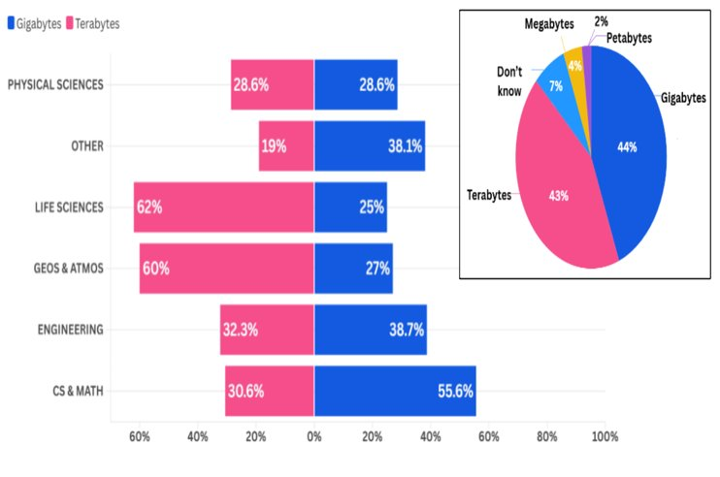
Where do you currently and/or plan to store your data for AI research? (Select all that apply)
Notes:
Approximately equal percentages of respondents indicated gigabyte- (44%) or terabyte-level (43%) needs (Fig. 3a, inset), but further analysis revealed marked differences among disciplines (Fig. 3a). Life Sciences (62%) and Geosciences & Atmospheric Sciences (60%) researchers expressed the largest need for terabyte-level storage, while the majority of CS & Mathematics researchers (55.6%) reported gigabyte-level storage requirements. Because of the magnitude of difference between providing gigabyte- and terabyte-level storage, in terms of hardware and infrastructure required, it is imperative that these more data-intensive disciplines are adequately surveyed when considering an HPC community’s data storage needs.

Slide 18
What type of hardware are you using for your AI work? (Select all that apply)
73% of respondents said they use one or more GPUs
Specialized AI accelerators (e.g. Google TPU, Intel Gaudi) were used by a small portion of respondents (~14%), except in GEOS & ATMOS (36%)

Slide 19
Software needs for AI research (bonus, not by discipline)

Slide 20
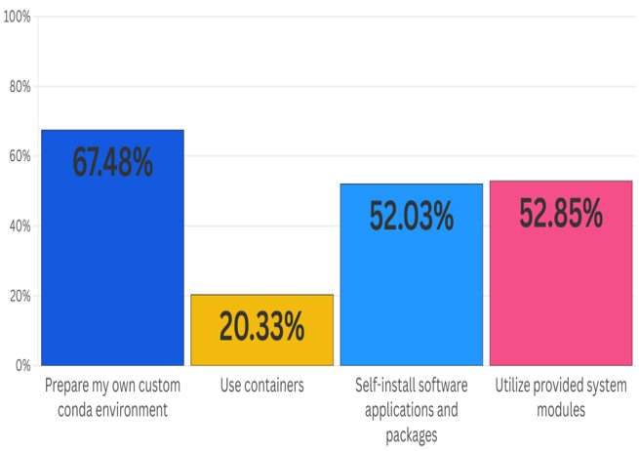
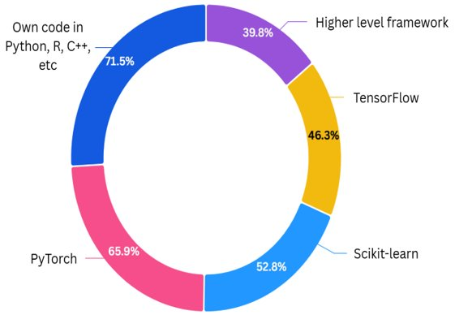
What type of software do you use in your AI work? (Select all that apply)
How do you install/use AI programs? (Select all that apply)
39.8%
71.5%
46.3%
65.9%
52.8%

Slide 21
AI research challenges and researcher training needs

Slide 22
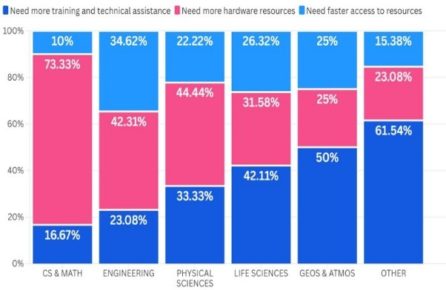
Of the AI research challenges, which is the single most important?
Notes:
For Life Sciences, Geosciences & Atmospheric Sciences, and ‘Other’ disciplines, most respondents indicate that training and technical assistance are their number one challenge. CS & Math, Engineering, and Physical Science researchers each identify the need for more hardware as their primary AI research challenge.

Slide 23
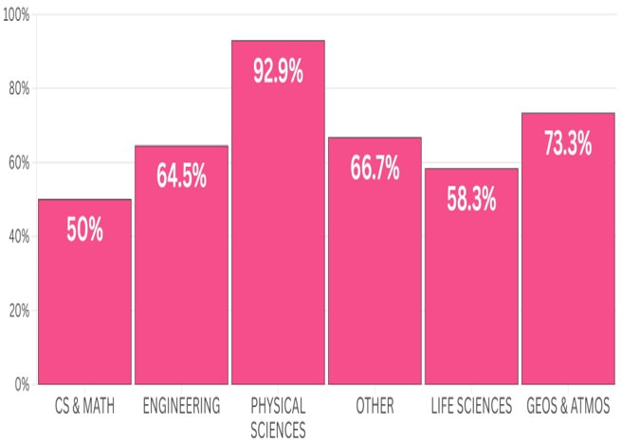
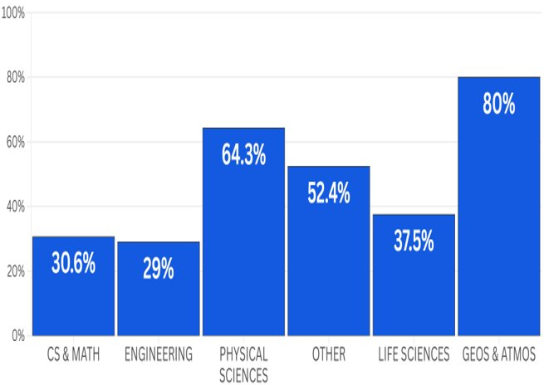
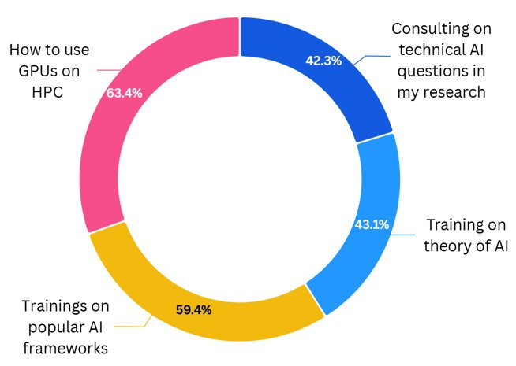
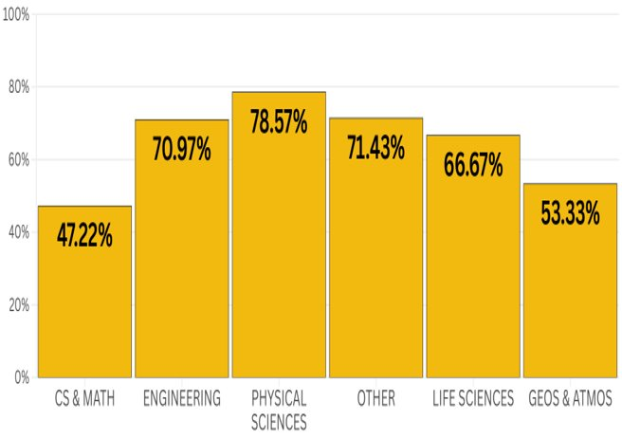
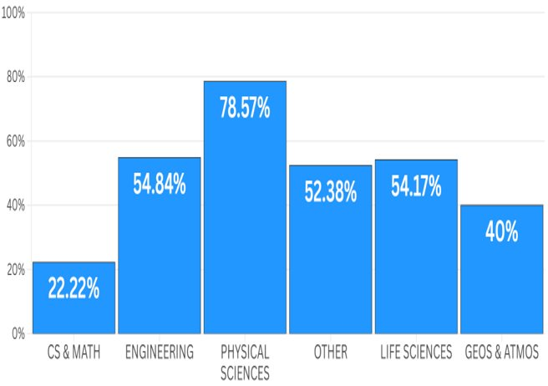
Are you interested in any of the following AI-focused workshops or events? (Select all that apply)
63.4%
42.3%
43.1%
59.4%
Notes:
Relative to other disciplines, researchers in the Physical Sciences and the Geosciences & Atmospheric Sciences appear to have a strong appetite for consulting on technical questions. Physical scientists, more than others, desire training in the theory of AI and how to use GPUs on HPC resources. Training on popular AI frameworks was selected by more than 50% of respondents in all disciplines except for CS & Math.

Slide 24
Conclusion
It is important to consider discipline-specific needs when designing systems, building new services, and developing training opportunities for AI research.
Examples:
CS & Mathematics researchers likely possess technical expertise to use advanced computing resources; identify access to hardware as their top challenge, have a greater gigabyte-level storage need than other disciplines → additional investments in AI-focused hardware or facilitating access to commercial cloud resources
Life Sciences researchers often use existing AI methods without modification, use Alpine (HPC) more than other disciplines, have terabyte-level storage needs, and an appetite for training and technical assistance → benefit from increased awareness of national HPC resources and training opportunities provided via ACCESS and NAIRR Pilot
Notes:
For example, our analysis suggests that CS & Mathematics researchers- who likely possess the technical expertise to utilize advanced computing resources, identify access to hardware as their top challenge, and have more gigabyte-level storage needs than other disciplines- may be best served by additional investments in on-prem, AI-focused hardware or by facilitating access to commercial cloud resources. On the other hand, Life Sciences researchers- who often use existing AI methods without modification, use CU Boulder HPC resources for AI research more than any other discipline, and have terabyte-level storage needs (making the commercial cloud costly)- would benefit from increased awareness of national HPC resources provided via ACCESS and the NAIRR Pilot.

Slide 25
Final Slide
Thank you.

